Slide 1
18ECE220T – Module 4 Cognitive Spectrum Management S – 1, 2, 3

Slide 2
S – 1 Cognitive transceiver Introduction & Cognitive transceiver architecture

Slide 3
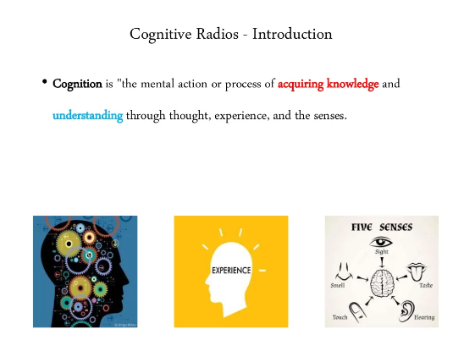

Slide 4
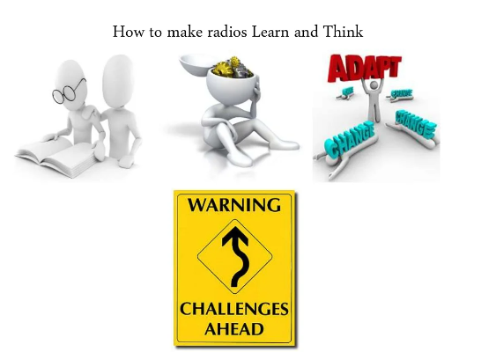
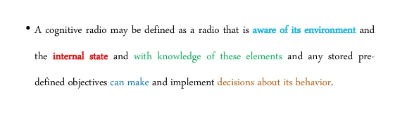

Slide 5
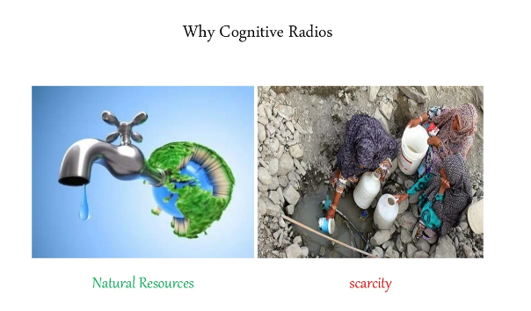

Slide 6
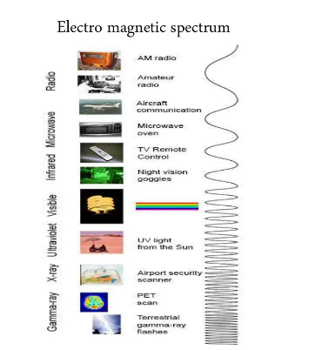
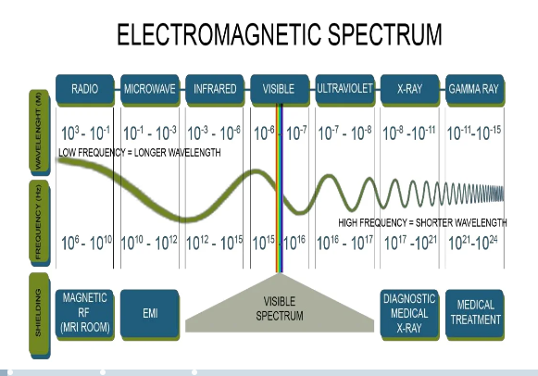

Slide 7
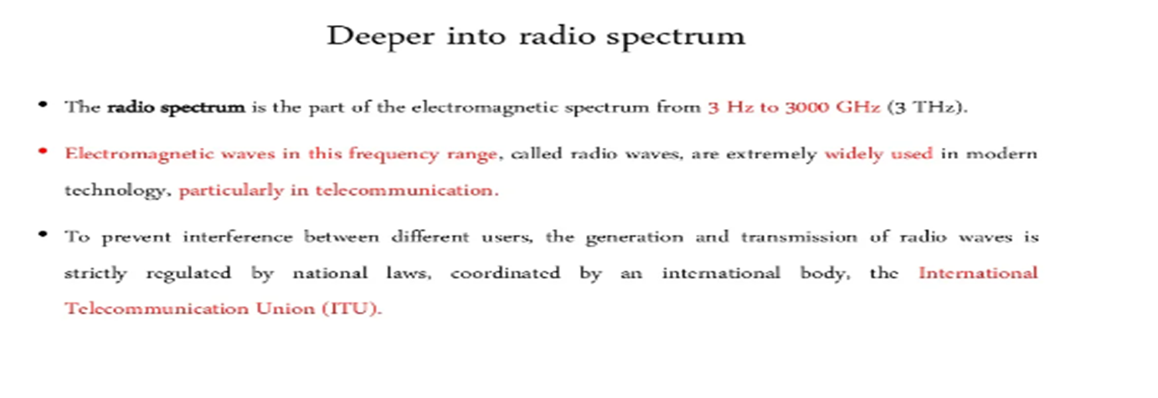

Slide 8
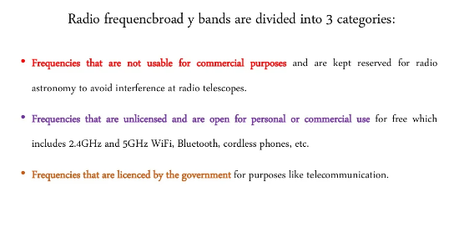

Slide 9
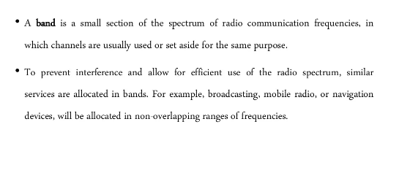


Slide 10
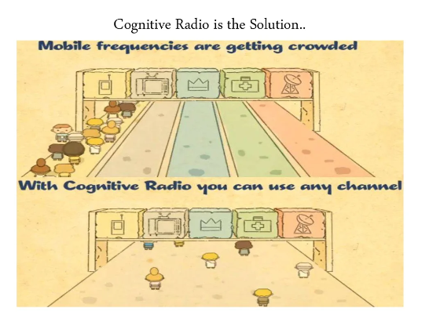

Slide 11
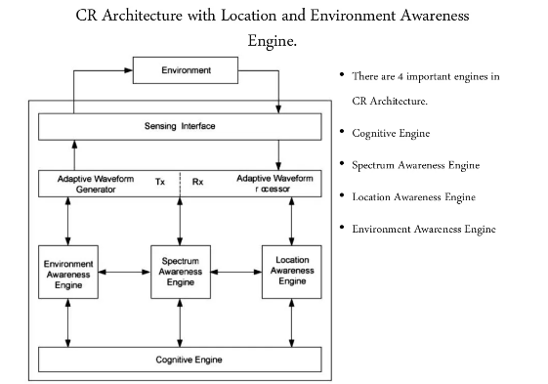

Slide 12
Introduction to Cognitive radio (CR)
Cognitive radio (CR) is a form of wireless communication in which a transceiver can intelligently detect which communication channels are in use and which ones are not.
The transceiver then instantly moves into vacant channels, while avoiding occupied ones. These capabilities help optimize the use of the available radio frequency (RF) spectrum.
It also minimizes interference to other users. And, by avoiding occupied channels, it increases spectrum efficiency and improves the quality of service (QoS) for users.
The wireless RF spectrum is a limited resource, usually allocated through a licensing process. In the U.S., it is the joint responsibility of the Federal Communications Commission (FCC) and the National Telecommunications and Information Administration (NTIA). The FCC administers the spectrum for non-federal (e.g., commercial) use, while the NTIA does the same for federal (e.g., military, FBI) use.

Slide 13
Cognitive radio network (CRN)
A cognitive radio network (CRN) is split into two main networks, a primary network and a secondary network.
The primary network owns the licensed band and consists of the primary radio base station and users.
The secondary network shares the unused spectrum with the primary network. It consists of the cognitive radio base station and users.

Slide 14
The three key capabilities that differentiate cognitive radio from traditional radio are:
Cognition: CR understands its geographical and operational environment.
Reconfiguration: According to this cognitive knowledge, CR can decide to dynamically and autonomously adjust its parameters.
Learning: CR can also learn from the experience, and experiment with new configurations in new situations.
The two main facets used in CR are spectrum sensing and spectrum database.

Slide 15
Spectrum Sensing
CR devices track the spectrum bands in their neighborhoods to identify users licensed to operate in that band. They also look for unused portions of the RF spectrum known as white spaces or spectrum holes.
These holes are created and removed dynamically and can be used without a license.
Spectrum sensing may be cooperative or non-cooperative. In the cooperative method, cognitive radio devices share spectrum information, while in the non-cooperative method, each CR device acts on its own.

Slide 16
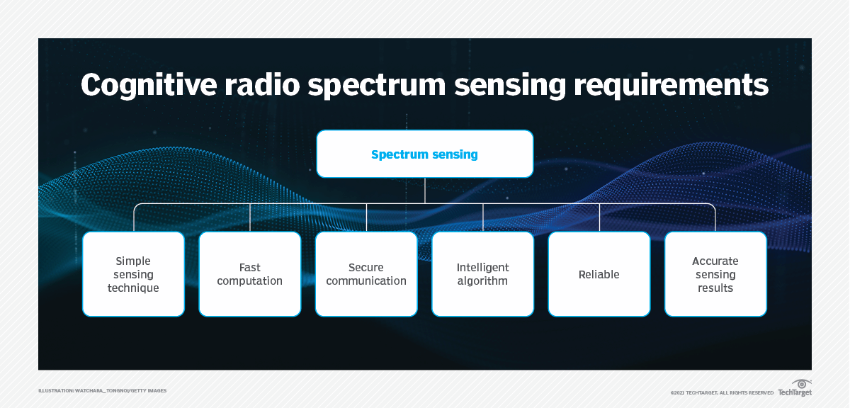
Cognitive radio devices track spectrum bands using a technique called spectrum sensing, which comes in two flavors (cooperative and non-cooperative) and has certain requirements.

Slide 17
Spectrum database
TV stations update their next week’s use of the RF spectrum in a database that the FCC maintains. Cognitive radio devices can seek information about free spectrum from this database, so they don’t have to rely on complex, time-consuming and expensive spectrum sensing techniques.
The drawback of this method is it’s difficult for the database to update dynamic spectrum activity in real time. As a result, CR devices may miss out on opportunities to access unused spectrum.
To support the growing number of devices that use the RF spectrum, a combined approach is useful. It ensures that devices can quickly and accurately detect unused spectrum and so improve QoS.

Slide 18
Types of cognitive radio
The two main types of CR are heterogeneous and spectrum-sharing.
In heterogeneous CR, operators run several radio access networks (RANs) using the same or different radio access technology (RAT) protocols. Heterogeneous cognitive radio uses a network-centric approach, and the frequency bands allocated to the various RANs are fixed.
In spectrum-sharing CR, several RANs share the same frequency band. They also coordinate with each other to use unoccupied sub-bands intelligently and optimally.
In both CR types, radio resources are optimized, and the QoS is much better than it would be with traditional radio.
Another way of categorizing CR is as full cognitive or spectrum sensing. Full cognitive CR takes into account all parameters that a wireless node or network can be aware of. Spectrum-sensing CR detects channels in the RF spectrum.

Slide 19
Cognitive Radio - Introduction
Spectrum is a finite resource. Efficient use of available spectrum is a key requirement for wireless system design
Wireless communication – Frequency range in use – 6 MHz to 10 GHz
Large-Area Service are catered by “less than 1 GHz” – So, limited Bandwidth availability.
Spectrum usage management
Regulatory approach - assigns a spectral band to a particular service, and even a particular operator. It allows network planning and good quality of service, but it is a waste of resources.
Cognitive radio approach - in which users adapt to the environment, including existing spectrum usage.

Slide 20
Types of Cognitive Radio
Ideal - A fully cognitive radio or “Mitola radio”
adapts all transmission parameters to the environment, i.e., modulation format, multiple-access method, coding, center frequency, bandwidth, transmission times, and so on.
A scientific curiosity, too complicated for practical purposes.
Practical - “spectrum-sensing cognitive radio,”
Adapts the transmission frequency, bandwidth, and time according to the environment. It is called as Dynamic Spectrum Access (DSA).

Slide 21
Motivation for DSA
A key motivation for DSA comes from the fact that with the current, fixed, assignments, spectrum is not exploited to its full extent at all times.
If, e.g., no active users are present in a cell of a cellular system, the spectrum is unused in this particular area.
Similarly, a lot of the spectrum assigned to TV transmission is not used. In general, this problem of white-space spectrum is quite pervasive.
For example, investigations in the U.S.A. estimate that in most locations, only 15% of spectrum is used.

Slide 22
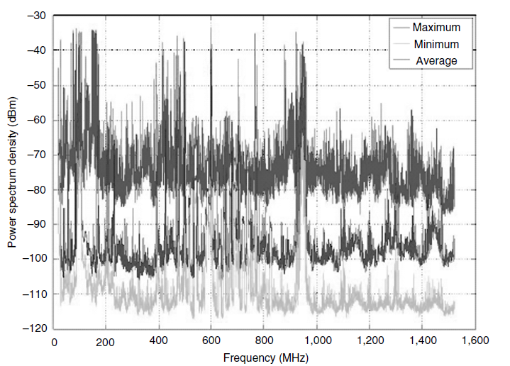
Motivation for DSA
Maximum, minimum, and average received power spectral density in the frequency band 20–1,520MHz with a 200-kHz resolution bandwidth of the receiver. Outdoor location
Image Courtesy: Reference [1]

Slide 23
Models of DSA (1)
Dynamic exclusive model
Spectrum reserved for particular service, but different providers can share the spectrum.
Joint usage of a single large frequency band (either by a single cellular operator or by a consortium of operators) results in higher spectral efficiency than the use of N smaller bands by N separate operators.
The sharing of the spectrum through trading (buying/selling or auctioning).
Regulator assigns spectrum to a particular user or service on an exclusive but time-varying basis. For example, a cellphone provider might have the right to use 50 MHz of spectrum in the morning and only 20 MHz at noon.

Slide 24
Models of DSA (2)
Open sharing model
All users can access the spectrum equally, subject to certain constraints on the characteristics of the transmit signal.
This approach is used in in the Industrial, Scientific, and Medical (ISM) bands. Ex. WiFi
The free access and ease of type approval contributed to the popularity of WiFi.
large number of WiFi devices, makes impossible for other services (especially medical and industrial services) to operate in this frequency band with a reasonable quality of service.

Slide 25
Models of DSA (3)
Hierarchical access model
This model assigns different priorities to different users.
Primary users – Served as if they have exclusive access to spectrum should be served in such a way that they experience the same service quality as if the b spectrum were reserved exclusively for their usage.
Secondary users are allowed to transmit, but only in such a way that they do not (or only “insignificantly”) affect the performance or service quality of the primary users.
It has to sense the current channel usage first and then determine a transmission strategy that does not disturb the current primary users (spectrum management).

Slide 26
Models of DSA (3)
Hierarchical access model Cont…
The key principle of hierarchical Cognitive Radio (CR) is that the secondary users do not disturb the primary users by following THREE approaches
Interweaving: CR identify parts of the spectrum that are not being used at a certain time, and transmits in those; Thus spectrum-sensing radio.
Overlay: CR detects the actually transmitted signal of the primary user, and adjusts its own signal in such a way that it does not disturb the primary receiver (RX) even though it transmits in the same band
Underlay: Here, the secondary radio actually does not adapt to the current environment, but always keeps its transmit Power Spectral Density (PSD) so low that its interference to primary users

Slide 27
Cognitive Transceiver Architecture (1)
Components in a transceiver structure:
Radio Frequency (RF),
Analog to Digital Converter (ADC),
Baseband processing.
Depending on the particular type of cognitive radio, one or more of those components is made adaptive.

Slide 28
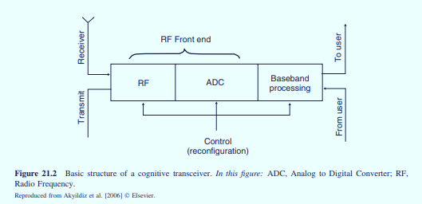
Basic Structure of a Cognitive Receiver
Image Courtesy: Reference [1]

Slide 29
Cognitive Transceiver Architecture (2)
In a spectrum-sensing cognitive radio, only the RF front end is different from a conventional receiver.
Components:
antennas,
Low Noise Amplifier (LNA),
local oscillator,
automatic gain control,
All above components should be wideband enough so that they can operate at all possible frequencies at which the cognitive radio might want to operate.
In the front end of the cognitive radio an adjustable local oscillator (e.g., a Voltage Controlled Oscillator, VCO) is a must.

Slide 30
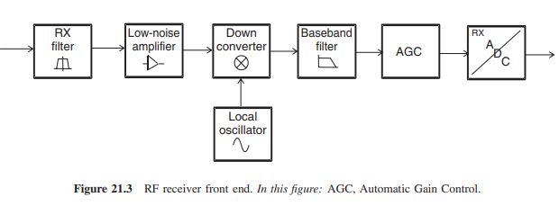
RF Receiver Front End
Image Courtesy: Reference [1]

Slide 31
Cognitive Transceiver Architecture (3)
In the cognitive Radio RF components like the LNA can be saturated by a out-of-band signal that the RX wants to demodulate at a specific time, but still within the overall receive band of the cognitive radio.
Solution: Place a tunable RF notch filters before the LNA. This will help to reduce the strong interference. However, the hardware cost of such filters is high, and the tunability is rather limited
For a fully cognitive radio, the baseband processing also has to be adaptive. So, the baseband processing is implemented as software on a Digital Signal Processor (DSP). That is why ‘Cognitive Radio’ is otherwise called as ‘Software Radio’.

Slide 32
S – 2 Interweaving & Principle of interweaving

Slide 33
Principles of Interweaving
Filling the hole - In an overlay system, a secondary user tries to identify spectral white space, and transmit at the times/locations/frequencies where primary users are not active; see Figure 21.4.
Clearly, the strategy involves three steps:
Spectrum Sensing 2. Spectrum Management 3. Spectrum Sharing
Spectrum sensing:
Find the “holes” (parts of the time– frequency plane are not used by primary users)
Sensing carried out in presence of noise. So, not completely reliable.
Determine the signal level of the detected radiation.

Slide 34
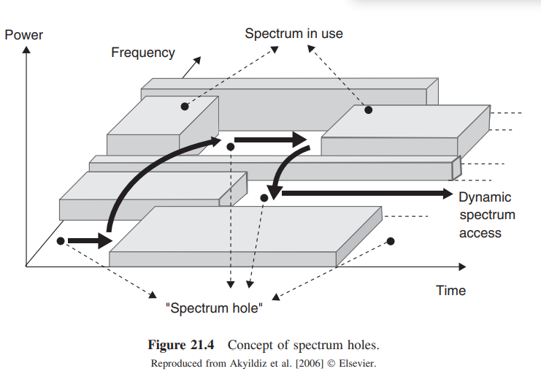
Concept of Spectrum Holes
Image Courtesy: Reference [1]

Slide 35
Principles of Interweaving
Spectrum management: the Secondary System (SS) decides when, and in which part of the spectrum, to transmit. This decision is difficult for reasons:
(i) the SS has only causal knowledge of the spectrum occupation, i.e., details of free-spectrum in the past and the present, but it has to make estimation about future functioning of primary system i.e., at the time when the SS will actually transmit,
(ii) SS takes decision on not so reliable the sensing information.
Spectrum sharing: a decision on how to divide up the free spectrum that the SS uses.
Spectrum sharing and spectrum management are strongly related – spectrum might be usable for a particular SS, but not for another.

Slide 36
S – 3 Principle of interweaving & Introduction to Spectrums-

Slide 37
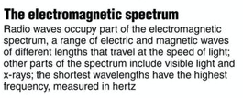

RECAP
Distance from crest to crest is called wavelength. Unit for wavelength is λ.
Time Period (T): The time duration in between crest to crest. Inverse of T is called frequency . Unit for frequency is Hz.

Slide 38
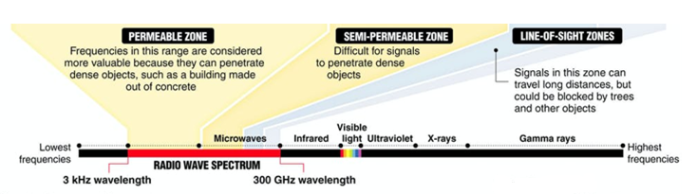
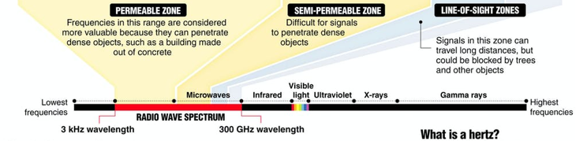
Spectrum (1/4)

Slide 39
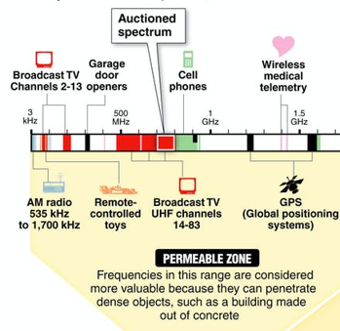
Spectrum (2/4)
Image Courtesy: Reference [2]

Slide 40
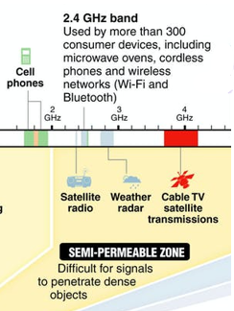
Spectrum (3/4)
Image Courtesy: Reference [2]

Slide 41
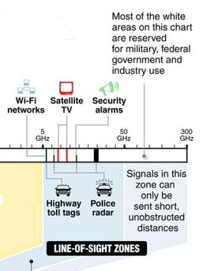

Spectrum (4/4)
Image Courtesy: Reference [2]

Slide 42
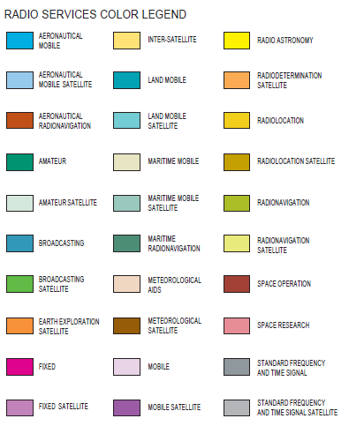
Radio Services
Image Courtesy: US Dept. of Commerce

Slide 43
References
Andrea Molish, “Advanced Wireless Communications: Principles and Practice”, Cambridge University Press.
Wireless spectrum is for sale ... but what is it? | https://theconversation.com/wireless-spectrum-is-for-sale-but-what-is-it-11794

Slide 44
Thank You

